Slide 1

A Review on State-of-the-art Text-To-SQL Solutions
by: Shahriar Yazdipour
Supervisors:
Prof. Dr.-Ing. Patrick Mäder
M. Sc. Martin Hofmann
Submission Date: 10.05.2023
Defense Date: 20.06.2023
Notes:
Welcome to the presentation, today we'll discuss an exciting area in the intersection of databases and machine learning: Text-to-SQL conversion.

Slide 2
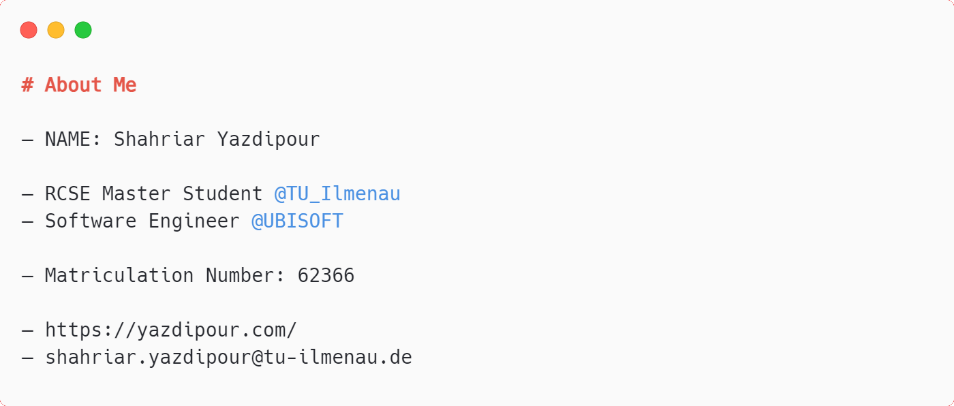
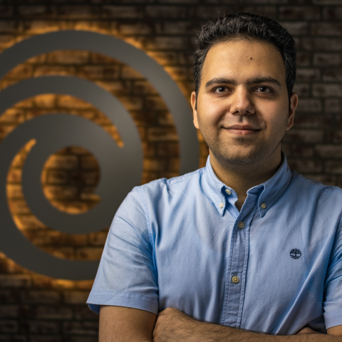
ABOUT ME

Slide 3
CONTENTS
OUTLINE
Introduction & Research Question
Datasets
Methods
Our Experiments (with GPT and T5)
Conclusion
Future Direction and Discussion

Slide 4
Introduction
& Research Question

Slide 5
Introduction & Research Question
SQL is the typical method for data retrieval in databases.

Slide 6
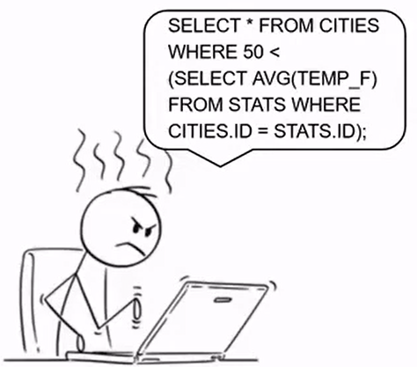
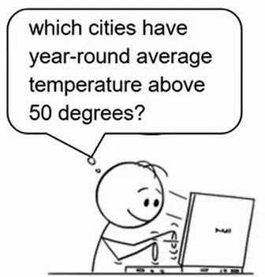
Introduction & Research Question
SQL is the typical method for data retrieval in databases.
Text-to-SQL allows for natural language interaction with structured data across various domains.

Slide 7
Introduction & Research Question
SQL is the typical method for data retrieval in databases.
Text-to-SQL allows for natural language interaction with structured data across various domains.
We explores various NLP technologies used in Text-To-SQL and study "How can we effectively apply NLP technologies to convert natural language text into SQL, overcoming the existing challenges in the field?"

Slide 8
Challenges
Encoding: Extract the meaning of NL
Translation: Transform the extracted meaning into another expression which is pragmatically equivalent to the NL meaning
Decoding: Produce the corresponding SQL queries
Notes:
Encoding: Deciphering intent in natural language input is a challenge due to potential ambiguity, varied interpretations, and typos.
----
The dynamic nature of databases, with changing schema and naming conventions, complicates accurate mapping of SQL elements.
The system needs to be robust to different types of user input, including informal language and errors, as well as handle rare edge cases.
Text-to-SQL must manage out-of-vocabulary words and make accurate predictions with biased training data.

Slide 9
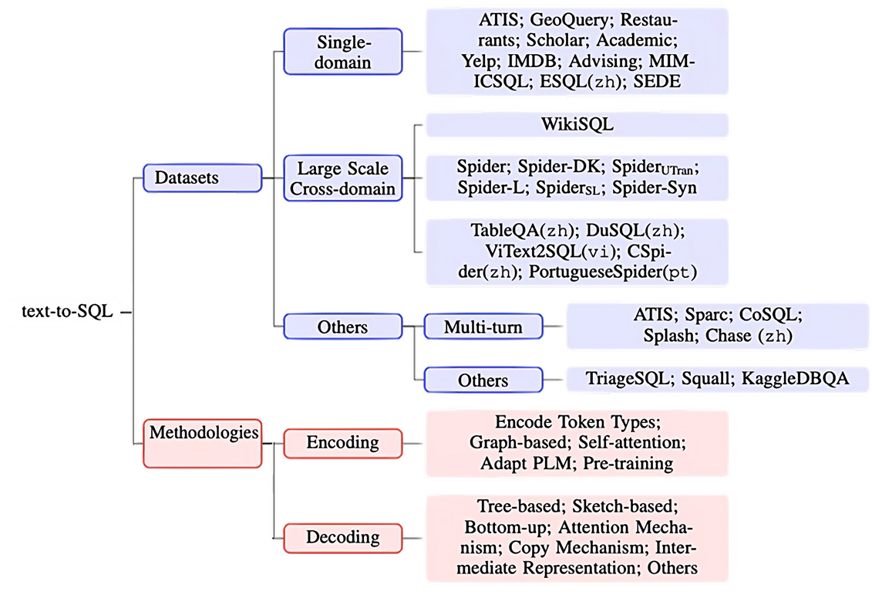
Notes:
With Text processing knowledge

Slide 10
Datasets

Slide 11
Datasets
Contain mainly: List of Utterances with their equivalent SQL queries
Provided by companies, universities or communities
Vary in
Complexity
Size
Annotation
They provide a standardized testbed for evaluating the performance of Text-to-SQL models
Classified into three categories:
Single domain datasets
Cross domain datasets
Others

Slide 12
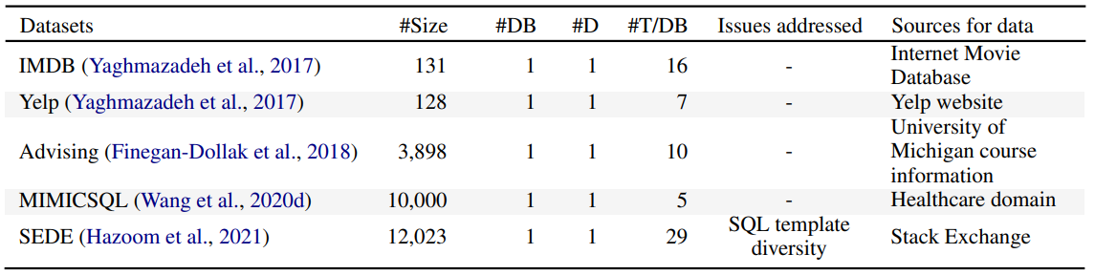
Benchmark Dataset:
Single domain datasets
Valuable specially for Real-Iife single domain knowledge
Early Datasets are limited in size

Slide 13
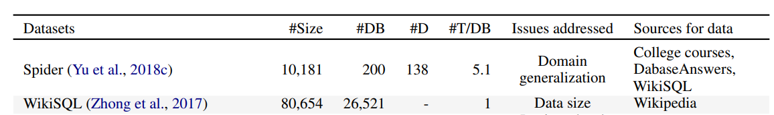
Benchmark Dataset:
Cross domain datasets
NL-SQL pairs span across multiple databases and domains.
Usually large in size
Test the generalizability of models
Some are generated datasets

Slide 14
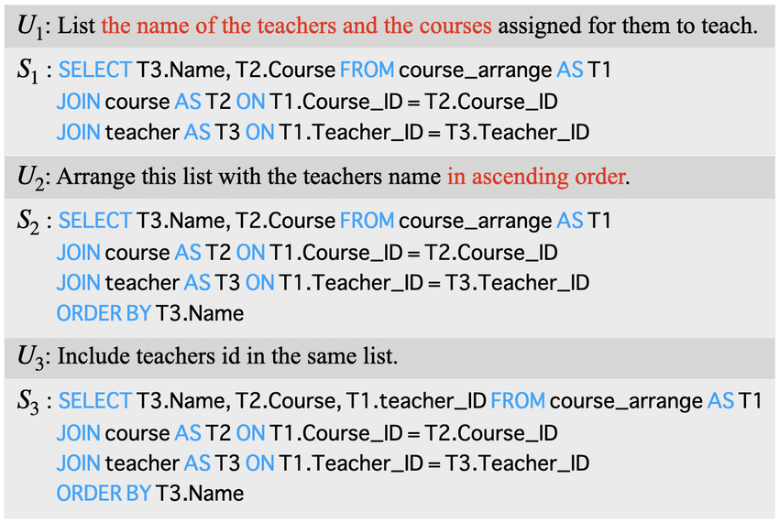
Benchmark Dataset:
Other
Multilingual
e.g: Cspider
Conversational Datasets:
e.g: CoSQL

Slide 15
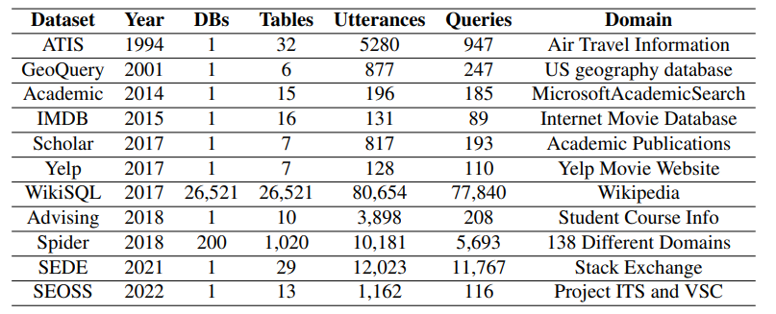
Datasets

Slide 16
Why not WikiSQL?
WikiSQL: A crowdsourced dataset containing 18,000 natural language and SQL pairs, gathered from Wikipedia tables
Issues with WikiSQL:
Simplicity
Many mistakes
Research suggests that the upper bound has been reached
Human accuracy estimated at 88%

Slide 17
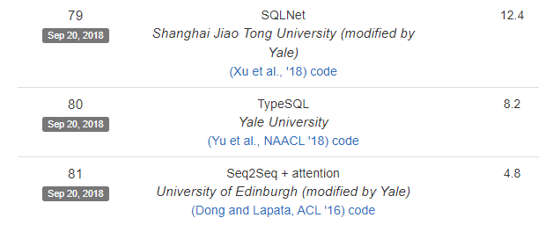
SPIDER
10,000 questions
5,000+ complex SQL queries
138 different domains
200 databases
It is unique in that it incorporates multiple datasets, unlike previous datasets that mostly used only one database
Include SELECT, WHERE, GROUP BY, HAVING, ORDER BY, LIMIT, JOIN, INTERSECT, EXCEPT, UNION, NOT IN, OR, AND, EXISTS, and LIKE.

Slide 18
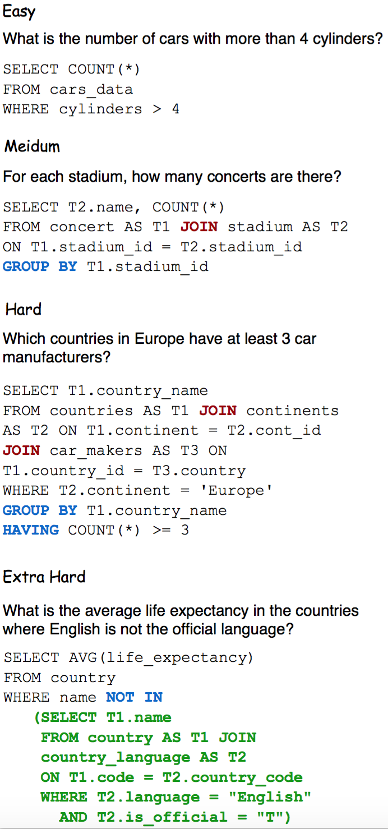
SPIDER
Notes:
The dataset is divided into "easy" and "hard" complexity levels, where "easy" includes simple SELECT queries, and "hard" can include JOINs, aggregations, subqueries, and more.

Slide 19
SEOSS (Software Engineering in Open-Source Systems)
Rich collection of NL expressions and corresponding Query.
166 uniquely phrased questions.
Based on real scenarios from Apache Pig project.
Expressions adapted from literature to match Apache Pig's ITS and VCS data.
Dataset is divided into two categories:
'Development' (81 queries)
'Research' (63 queries)
Enhanced with 22 records from stakeholder comments across 33 Apache projects.
By Mr. Tomova and Mr. Hofmann and Prof. Mäder in TU Ilmenau

Slide 20
Methods

Slide 21
Methods
Early Text-to-SQL approaches relied on rule-based and template-based methods.
Limitations: inability to handle complex queries and variations in natural language inputs.
Recent approaches to Text-to-SQL have focused on using neural networks and machine learning techniques.
Needs large amounts of training data to learn the relationship between natural language and SQL.
Leverage pre-trained models.

Slide 22
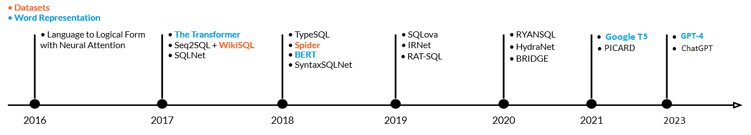
Natural Language Representation
Text Processing in NLP involves several steps:
Tokenization: Byte Pair Encoding (BPE), …
Embedding: GloVe, Word-Piece Embedding, …
Prediction
Transformers
The rise of Language Models
BERT
TaBERT
….
Notes:
Tokenization: Fundamental NLP process breaking raw text into tokens (individual words, phrases, etc.). Methods include rule-based, statistical, subword tokenization, Byte Pair Encoding (BPE), subword-level, and character-level tokenization.
Word Embeddings: WordPiece embeddings break down words into smaller units (pieces), addressing out-of-vocabulary (OOV) words. Words are divided into subword units stored in a shared vocabulary. WordPiece embeddings represent each piece as a dense vector, combined to represent the whole word.
For example, the word 'embedding' could be tokenized into ['em', '##bed', '##ding']. Here, 'em' stands on its own as a token, but '##bed' and '##ding' do not and are understood to be part of the same original word.

Slide 23
T5-PICARD
Notes:
Slide 1: Present your findings, ensuring they are well structured.
Slide 2: Use tables, graphs, or diagrams to visually present your findings.
Slide 3: Discuss your interpretation of the findings, highlighting their significance.

Slide 24

T5 (Text-To-Text Transfer Transformer)
Leverages the BERT encoder-decoder architecture.
Using C4 Dataset
Pre-training: Text corruption by randomly dropping out words, replaced with unique sentinel tokens.
Highly adaptable, can be fine-tuned for a range of tasks
Notes:
Transfer Learning: u do Unsupervised training on unlabeled data, then fine-tuning on labeled, task-specific data.

Slide 25
PICARD (Parsing Incrementally for Constrained Auto-Regressive Decoding)
Challenges in Text-to-SQL:
SQL must be valid
SQL must correctly represent the meaning of the question
Common solution for 1st challenge:
Special constrained decoder architecture that always produces valid SQL which it needs to be trained from scratch and it limits generality, at odds with 2nd challenge
PICARD solution:
Constrain decoder to produce valid SQL
Use existing pre-trained model
Incremental Parsing enforces syntactic and semantic constraints
Notes:
Language models are great at generating code
But:
The code often violates syntactical and semantical constraints (unusable)
Pre-training is insufficient to assure correctness
So far, there has been a trade-off between these two goals:
How is PICARD different from existing constrained decoders?
It’s an incremental parsing algorithm that integrates with ordinary beam search.
It doesn’t require any training.
It doesn’t require modifying the model.
It works with any model that generates a sequence of tokens (including language models).
It doesn’t require a special vocabulary.
It works with character-, sub-word-, and word-level language models.

Slide 26
Constrained Decoding
Improves quality of outputs by imposing constraints or using auxiliary models during decoding.
PICARD uses
Constraints to avoid generating invalid tokens.
Using Attoparsec parsing library that supports incremental input.
If the parsing is successful, it will return the final AST. If not, it will return a failure value.
Notes:
Parsing Fragmented input until the input is complete.
Abstract Syntax Tree.

Slide 27
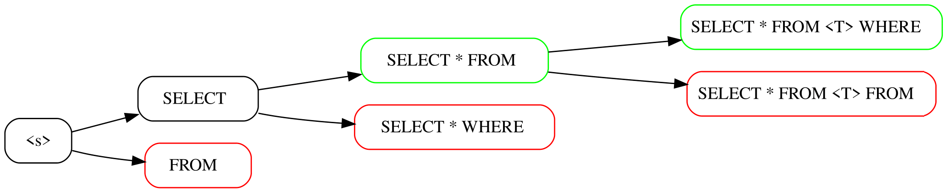
Incremental Constrained
Beam Search

Slide 28
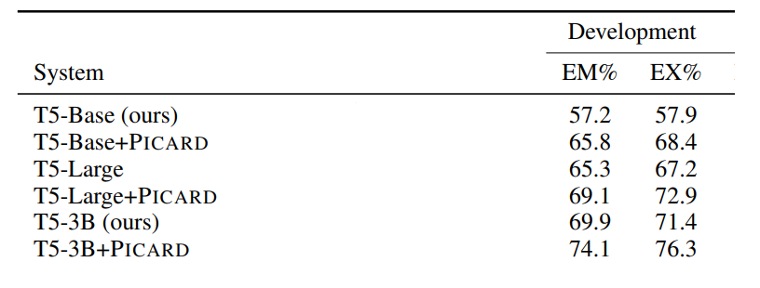
PICARD on Spider
Using T5-3B
Without PICARD: 12% invalid SQL predictions on Spider
With PICARD: 2% invalid predictions

Slide 29
Evaluation
Exact Set Matching
Compares predicted SQL queries with reference queries, disregarding the order of elements.
If the set of predicted queries is entirely in the reference query, the score is 1.0 else it's 0.0.
Unlike "Exact Matching", which requires a perfect match in terms of element order, capitalization, and spaces, "Exact Set Matching" is more forgiving.

Slide 30
Evaluation
Execution Accuracy
Measures the percentage of correctly generated SQL queries that execute successfully on a database.
Higher values denote better performance, with this metric focusing on syntactic and semantic correctness of the generated queries.
As "Execution Accuracy" does not assess the relevance or comprehensiveness of the returned data, it's often combined with other metrics

Slide 31
Experiments
& Findings
Notes:
Slide 1: Present your findings, ensuring they are well structured.
Slide 2: Use tables, graphs, or diagrams to visually present your findings.
Slide 3: Discuss your interpretation of the findings, highlighting their significance.

Slide 32
SEOSS + T5-PICARD
Notes:
Slide 1: Present your findings, ensuring they are well structured.
Slide 2: Use tables, graphs, or diagrams to visually present your findings.
Slide 3: Discuss your interpretation of the findings, highlighting their significance.

Slide 33
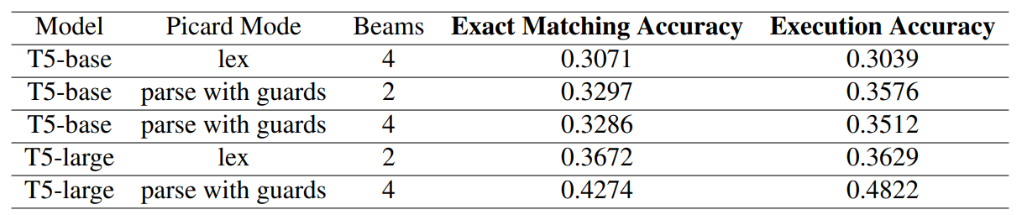
SEOSS evaluation with T5 PICARD
Experiment conducted using SEOSS dataset and the PICARD model.
Comparison made with SQLNet and RatSQL.
T5-Base and T5-Large models used for the experiment.
Goal: To see if PICARD can achieve similar results to SQLNet and RatSQL.
Notes:
Lex generally refers to a process of lexical analysis or tokenization, which is the process of converting a sequence of characters into a sequence of tokens. In the context of Text-to-SQL, this could mean breaking down the input into individual words or symbols.
Parsing is a more complex process that usually follows lexical analysis. It involves interpreting the tokens based on grammar rules, to understand the structure and meaning of the input. The term "guards" could refer to certain conditions or constraints that are used during the parsing process.

Slide 34
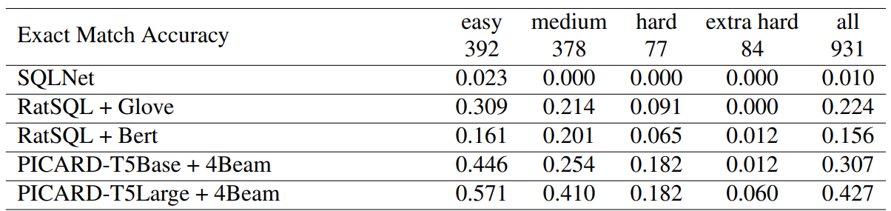
SEOSS evaluation with T5 PICARD
Experiment conducted using SEOSS dataset and the PICARD model.
Comparison made with SQLNet and RatSQL.
T5-Base and T5-Large models used for the experiment.
Goal: To see if PICARD can achieve similar results to SQLNet and RatSQL.

Slide 35
SEOSS + ChatGPT
Notes:
Slide 1: Present your findings, ensuring they are well structured.
Slide 2: Use tables, graphs, or diagrams to visually present your findings.
Slide 3: Discuss your interpretation of the findings, highlighting their significance.

Slide 36
SEOSS evaluation with ChatGPT
The Generative Pre-trained Transformers (GPT) architecture has significantly influenced natural language processing with self-attention mechanisms, allowing efficient training and superior NLP task performance.
GPT models are inherently generative, designed to create text based on provided context.
They are pre-trained on a vast volume of text data to learn structure and patterns in natural language.
Number of parameters:
GPT-1 : 117 million
GPT-2 :1.5 billion
GPT-3 :175 billion
GPT-4 has not been officially disclosed. (rumor 170 trillion)
Notes:
Lex generally refers to a process of lexical analysis or tokenization, which is the process of converting a sequence of characters into a sequence of tokens. In the context of Text-to-SQL, this could mean breaking down the input into individual words or symbols.
Parsing is a more complex process that usually follows lexical analysis. It involves interpreting the tokens based on grammar rules, to understand the structure and meaning of the input. The term "guards" could refer to certain conditions or constraints that are used during the parsing process.

Slide 37
Prompt Engineering
Prompt: Open-ended Instruction provided by user to LLM
Prompt Engineering is an emerging field aimed at enhancing the performance of large language models (LLMs) across diverse applications by refining prompts.
Mastering prompt engineering enables deeper insights into the potential of LLMs and augments their proficiency in handling various tasks.
With OpenAI API you can use different AI model versions with custom parameters, for your specific task.
Notes:
Prompt engineering involves using LLM APIs for tasks like summarization, inference, text transformation, and expansion. It entails systematic development of high-quality prompts for optimal results.
Temperature, Maximum length, Top P, and Frequency and Presence penalties.
Top P is another method to control output randomness and creativity, and it influences the range of available tokens based on their relevance to the prompt.
Frequency and Presence penalties in the Playground regulate repetition in the generated text. Frequency penalties minimize word repetition, while Presence penalties reduce recurring specific topics. Higher values on the penalty scale indicate lower likelihoods of repeated tokens.
Temperature controls the model's creativity, with a lower value yielding predictable responses and a higher value leading to creative outputs.
A temperature of 0 was found best for producing accurate SQL queries in this study.

Slide 38
Prompt Engineering
Roles:
System: Offers guidance or establishes context for the assistant in the conversation.
User: Usually a question or request submitted by the user for the assistant to process.
Assistant: Processes the messages from the system and user in their order and generates a response. System instructions can guide the assistant's behavior in the conversation.
The assistant prompt is used to provide historical context.
Notes:
Prompts have associated roles that supply context for the conversation and influence the model's response. These roles can be "system," "user," or "assistant.“
The approach to discovering the optimal prompt for text-to-SQL ChatGPT agents starts with defining a set of criteria to evaluate the quality and accuracy of the generated SQL commands.
Evaluation criteria include syntactic correctness (adherence to SQL syntax rules) and semantic correctness (alignment with the meaning and intent of natural language queries) of the SQL commands.

Slide 39
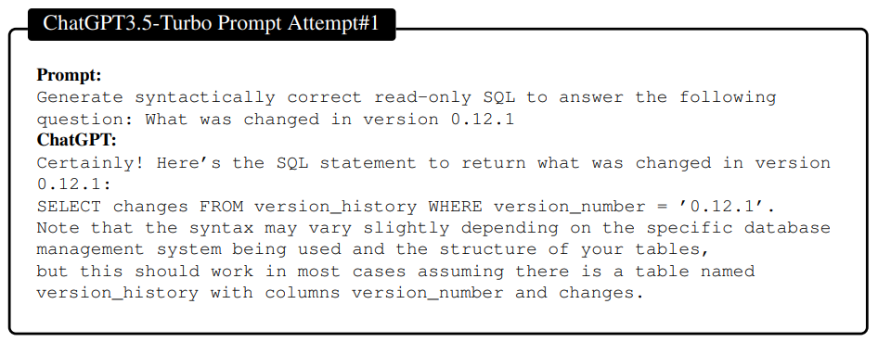
Notes:
System: A high-level directive for the conversation, typically used to offer guidance or establish the context for the assistant. • User: A message submitted by the user, usually in the form of a question or a request for the assistant to process. • Assistant: The response produced by the assistant is based on the context provided by the system and user messages. The assistant processes the messages according to their order in the list and generates a response accordingly. Employing system instructions can effectively guide the assistant’s behavior throughout the conversation. The assistant prompt is usually used to provide historical context for the conversation.

Slide 40
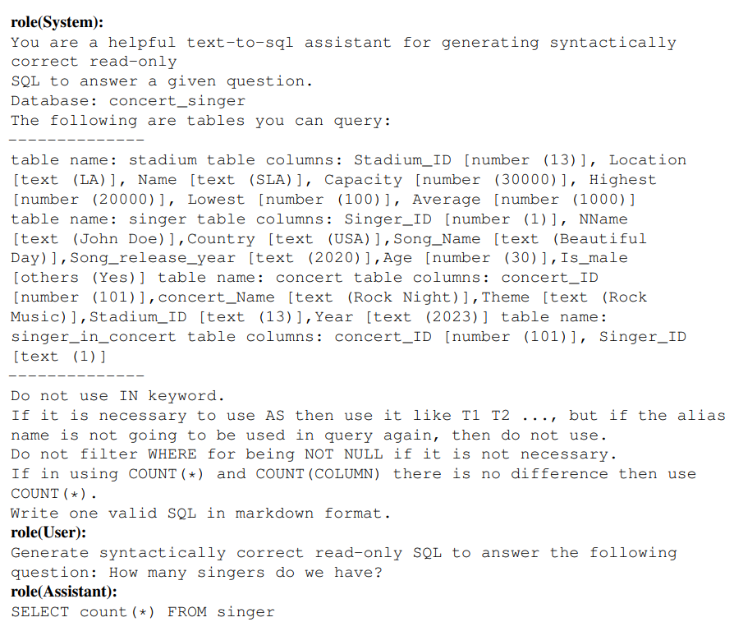
Experiments

Slide 41
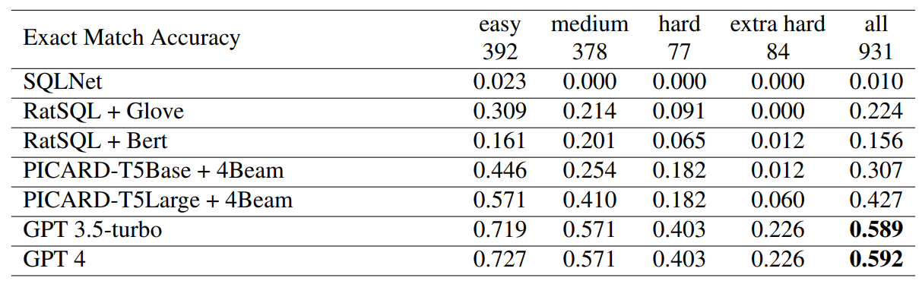
SEOSS Accuracy Comparison

Slide 42
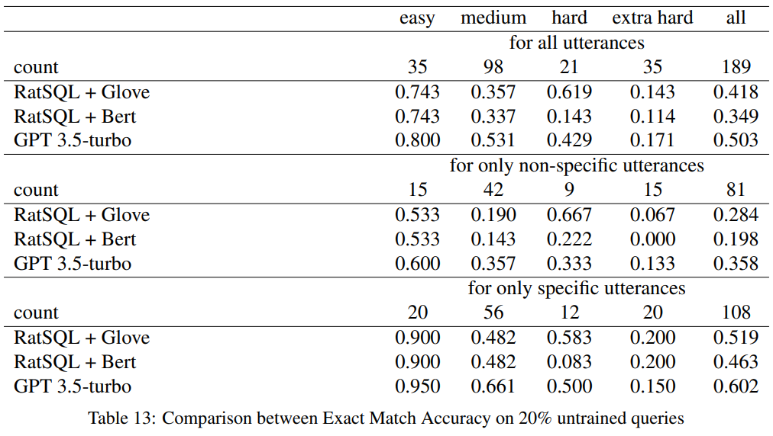
EMA: ChatGPT vs 20% Trained Models

Slide 43
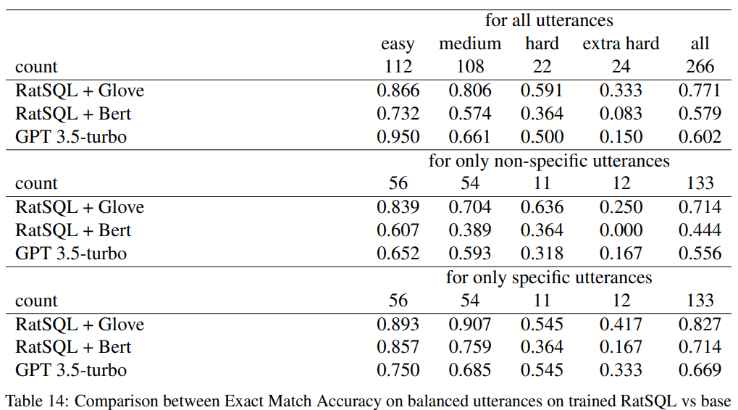
EMA: ChatGPT vs Trained Models
Notes:
Does this mean it is overfitting???

Slide 44
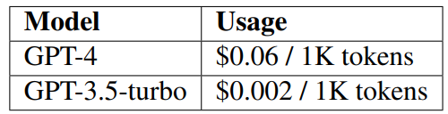
Cost/Resource
As a rough rule of thumb, 1 token is approximately
4 characters or 0.75 words for English text.
(ChatGPT-3.5 has 2048 tokens limit, so its roughly 8192 char including roles and history)

Slide 45
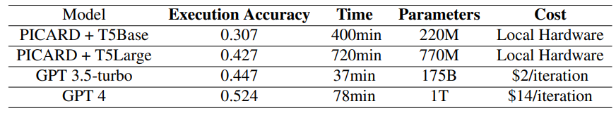
Cost/Resource in SEOSS Experiment
Notes:
System: A high-level directive for the conversation, typically used to offer guidance or establish the context for the assistant. • User: A message submitted by the user, usually in the form of a question or a request for the assistant to process. • Assistant: The response produced by the assistant is based on the context provided by the system and user messages. The assistant processes the messages according to their order in the list and generates a response accordingly. Employing system instructions can effectively guide the assistant’s behavior throughout the conversation. The assistant prompt is usually used to provide historical context for the conversation.

Slide 46
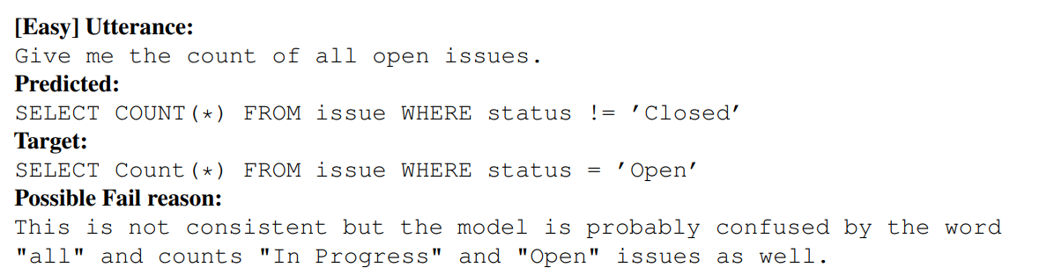
SEOSS Failed Cases

Slide 47
SPIDER + ChatGPT

Slide 48
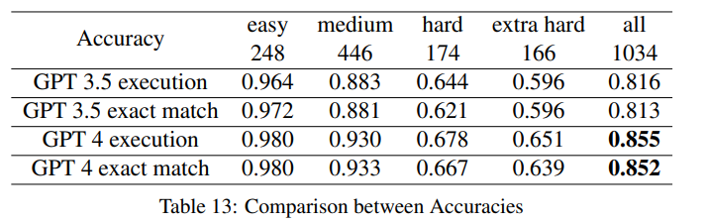
SPIDER evaluation with ChatGPT

Slide 49
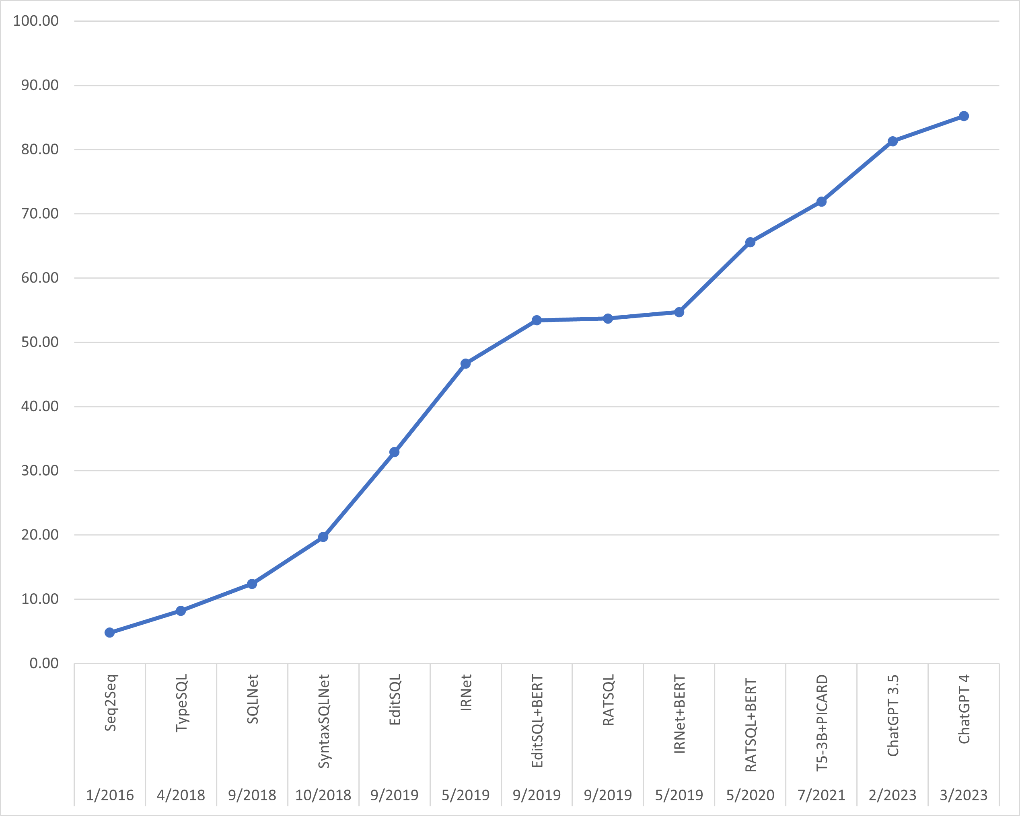
SPIDER evaluation with ChatGPT

Slide 50
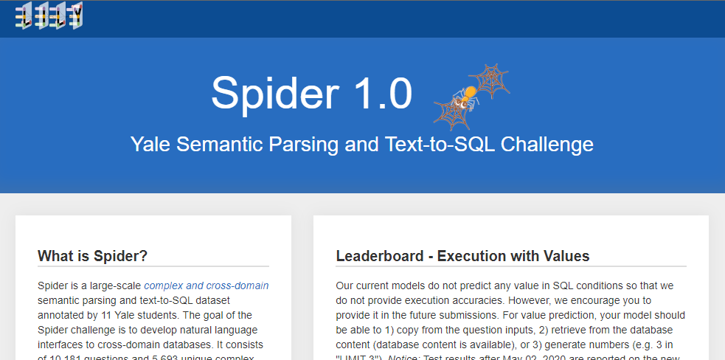
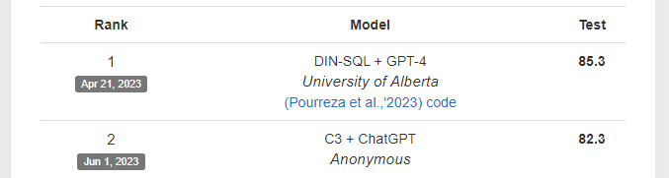
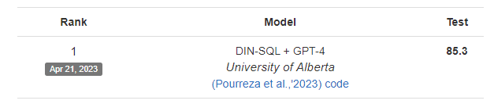
Un/Fortunately :)

Slide 51
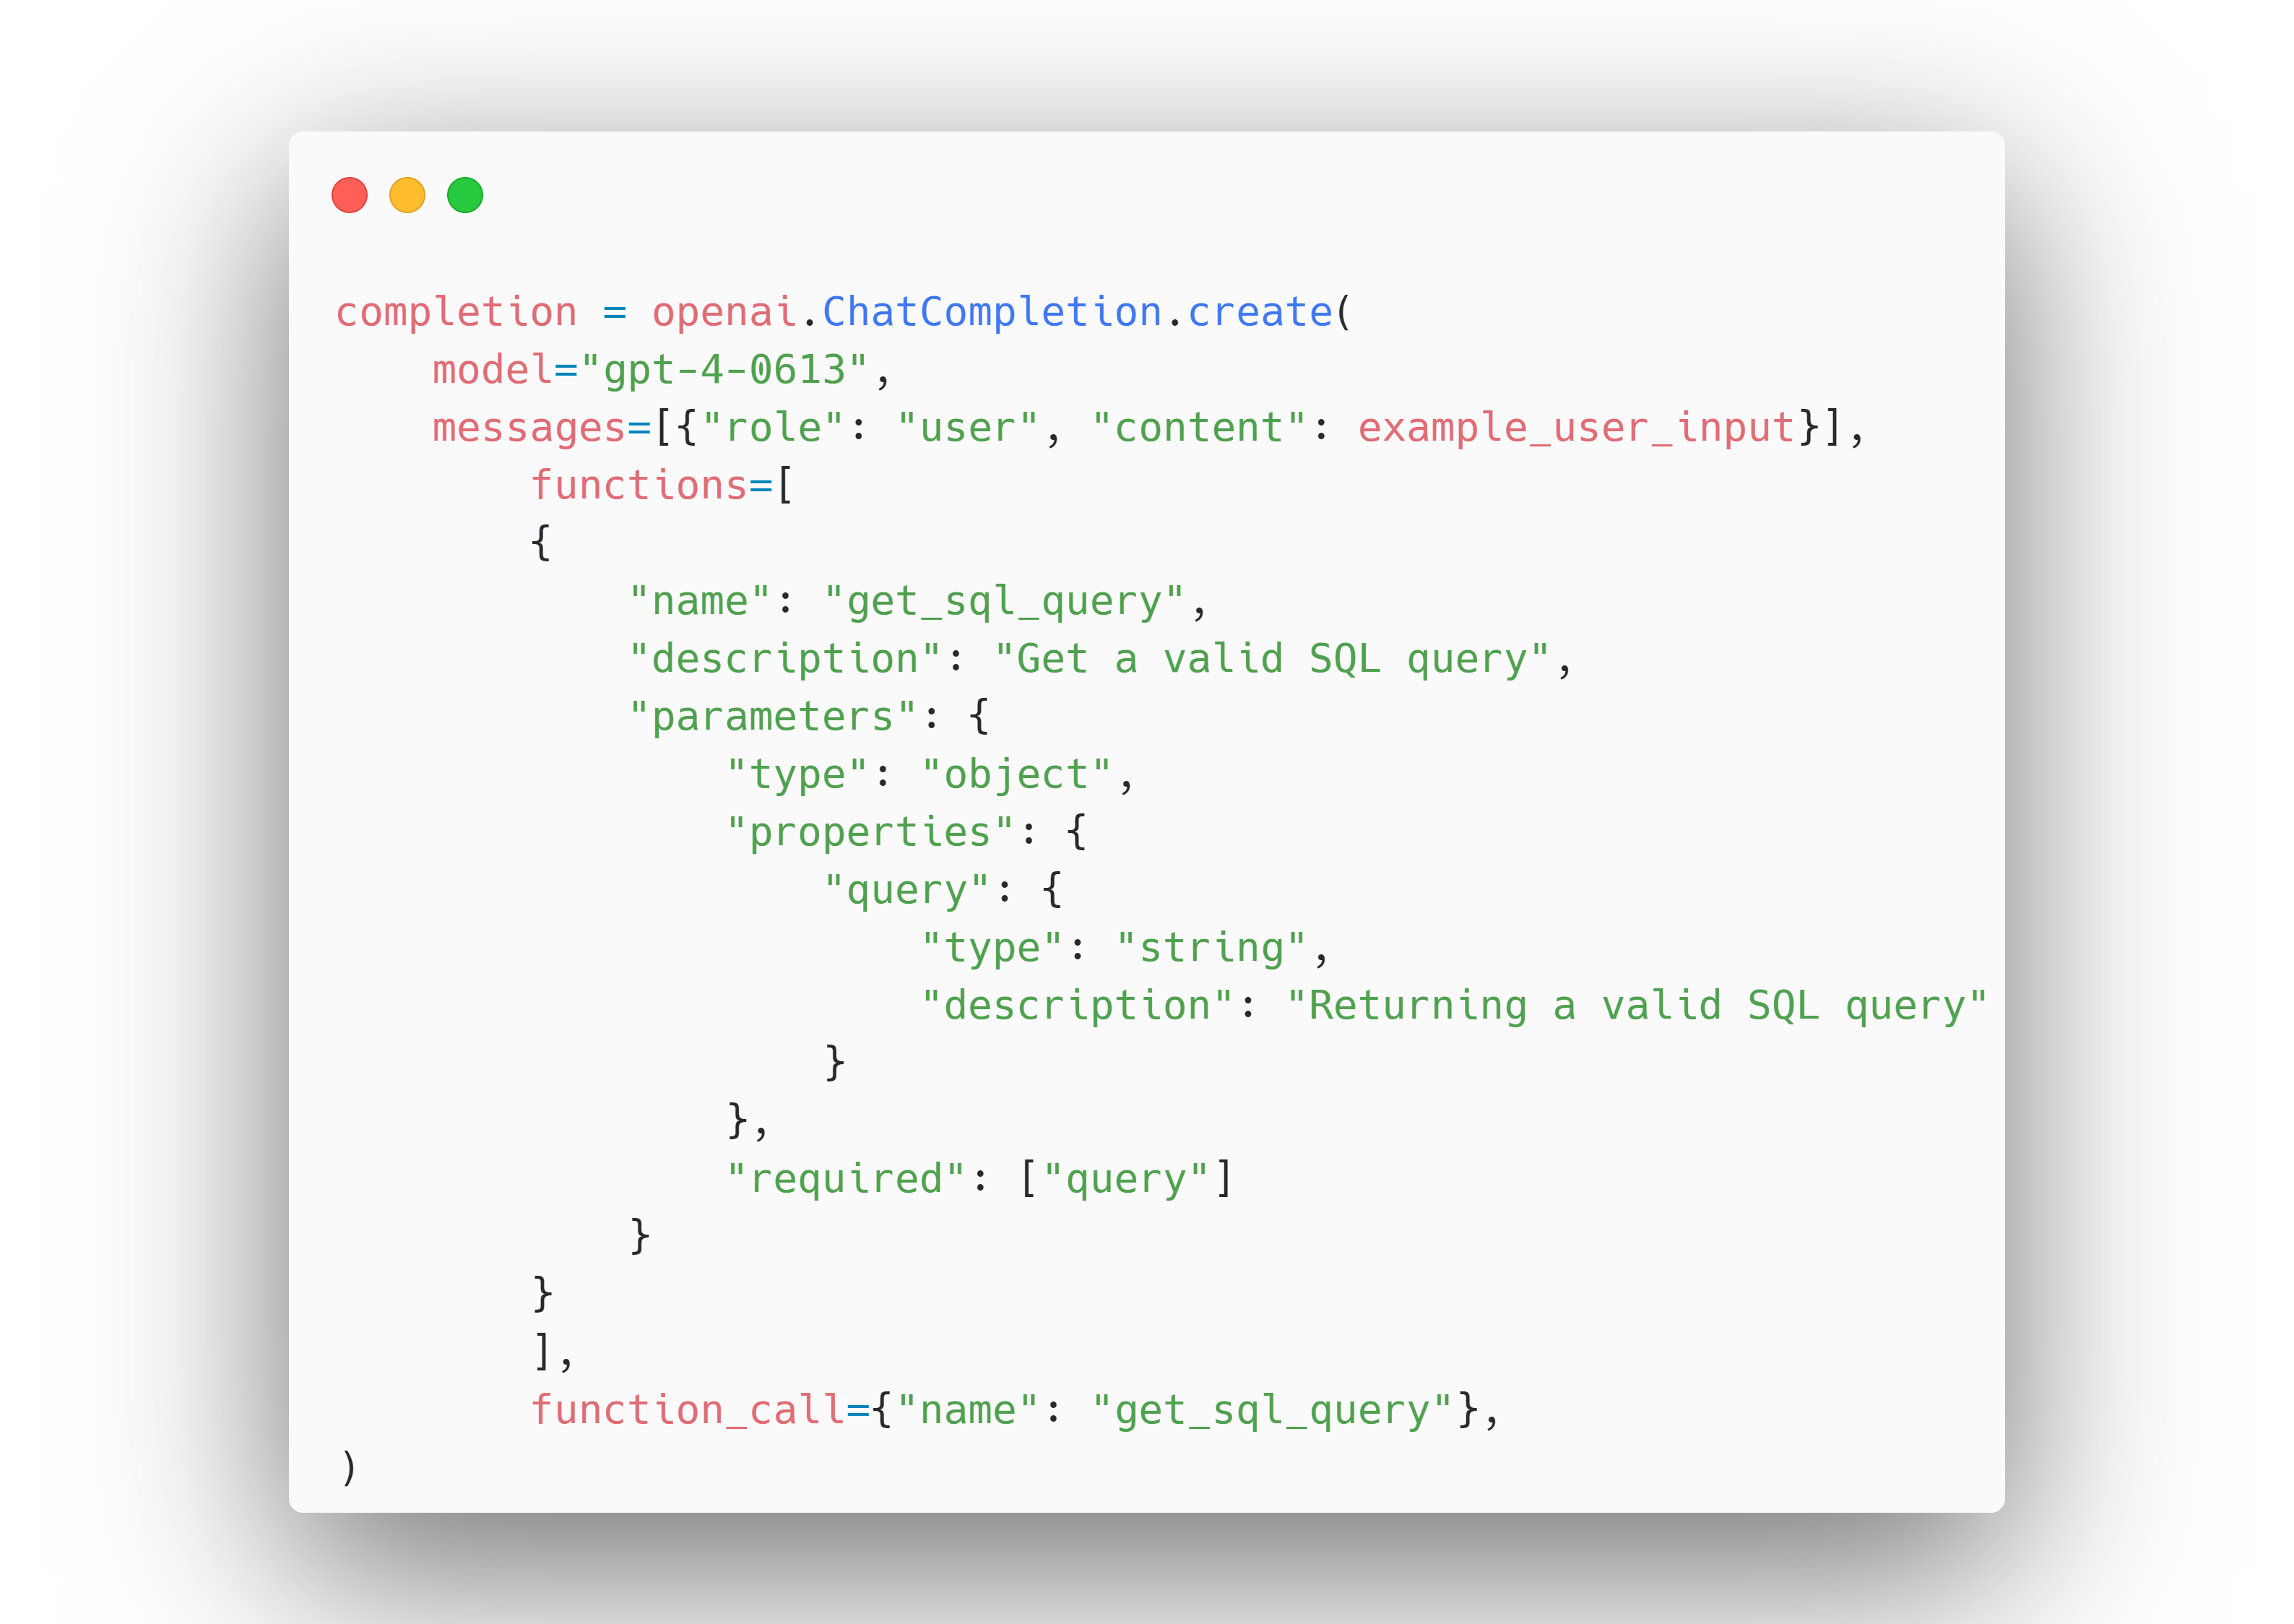
Update GPT-4-0613
Notes:
deterministic result

Slide 52
Conclusion
& Future Directions
Notes:
Slide 1: Summarize important steps and key findings of your research. Provide an innovative and interesting outlook for future research.
Slide 2: Conclude with the implications of your findings and any final thoughts.

Slide 53
Future Directions
Address performance loss in other domains and also when dealing with dynamic database structure
Incorporate DB management and modification commands.
Do we need to a new dataset?
Explore conversational and multilingual Text-to-SQL applications.
My next project ChatGPT + Text-to-SamQL-to-SQL!
Is it possible to combine PrivateGPT or OpenLLM with PICARD?
Discuss if Spider is still relevant?! Spider is the new WikiSQL?
Notes:
Slide 1: Summarize important steps and key findings of your research. Provide an innovative and interesting outlook for future research.
Slide 2: Conclude with the implications of your findings and any final thoughts.

Slide 54
Conclusion
Rapid growth of Text-to-SQL domain, getting mature.
Performance influence of datasets like Spider and SEOSS.
PICARD-T5 identified as promising for fine-tuning with high-performance computing resources.
Potential and Impact of LLMs on Text-to-SQL.
Potential for prompt learning to enhance Text-to-SQL robustness.
Future of this research field

Slide 55
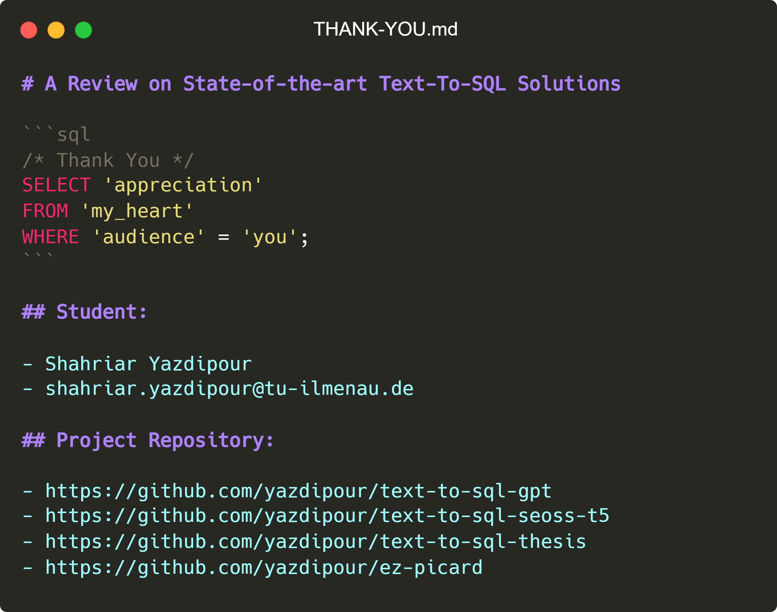
Thanks,
Any Questions?
Notes:
We now welcome any questions or comments you might have. -----
# A Review on State-of-the-art Text-To-SQL Solutions
```sql
/* Thank You */
SELECT 'appreciation'
FROM 'my_heart'
WHERE 'audience' = 'you';
```
## Student:
- Shahriar Yazdipour
- shahriar.yazdipour@tu-ilmenau.de
## Project Repository:
- https://github.com/yazdipour/text-to-sql-gpt
- https://github.com/yazdipour/text-to-sql-seoss-t5
- https://github.com/yazdipour/text-to-sql-thesis
- https://github.com/yazdipour/ez-picard

Slide 56
References
Naihao Deng, Yulong Chen, and Yue Zhang. Recent advances in text-to-sql: A survey of what we have and what we expect, 2022.
Qin Lyu, Kaushik Chakrabarti, Shobhit Hathi, Souvik Kundu, Jianwen Zhang, and Zheng Chen. Hybrid ranking network for text-to-SQL. 2020.
Torsten Scholak, Nathan Schucher, and Dzmitry Bahdanau. PICARD: Parsing incrementally for constrained auto-regressive decoding from language models. In Proceedings of the 2021 Conference on Empirical Methods in Natural. Language Processing, pages 9895–9901. Association for Computational. Linguistics, November 2021.
lvis Saravia. Prompt Engineering Guide. https://github.com/dair-ai/PromptEngineering-Guide, 12 2022.
Spider: A Large-Scale Human-Labeled Dataset for Complex and Cross-Domain Semantic Parsing and Text-to-SQL Task. 2018. Tao Yu and Rui Zhang and Kai Yang and Michihiro Yasunaga and Dongxu Wang and Zifan Li and James Ma and Irene Li and Qingning Yao and Shanelle Roman and Zilin Zhang and Dragomir Radev
Jacob Devlin, Ming-Wei Chang, Kenton Lee, and Kristina Toutanova. BERT: pre-training of deep bidirectional transformers for language understanding. CoRR, abs/1810.04805, 2018.
Ashish Vaswani, Noam Shazeer, Niki Parmar, Jakob Uszkoreit, Llion Jones, Aidan N. Gomez, Lukasz Kaiser, and Illia Polosukhin. Attention is all you need, 2017.
You can find Full list of references in thesis document.

Slide 57
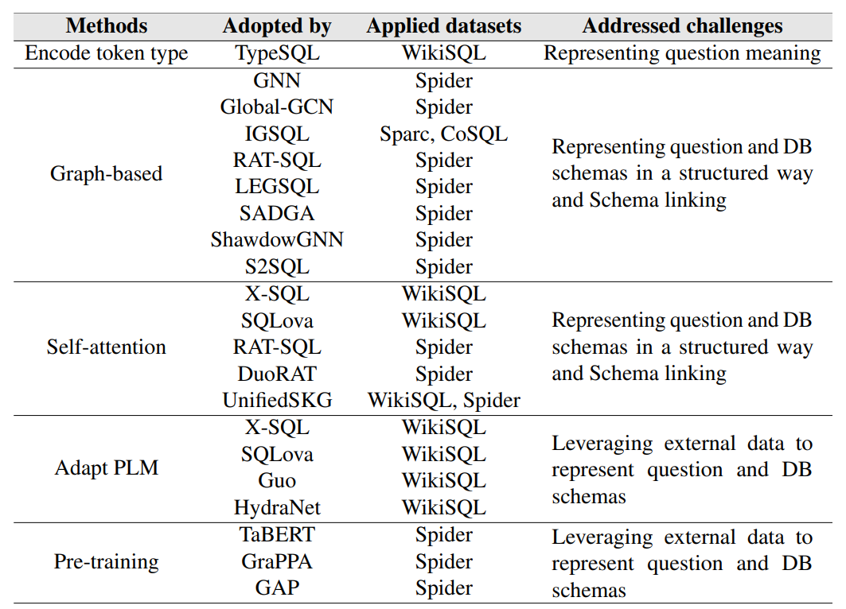
Encoders

Slide 58
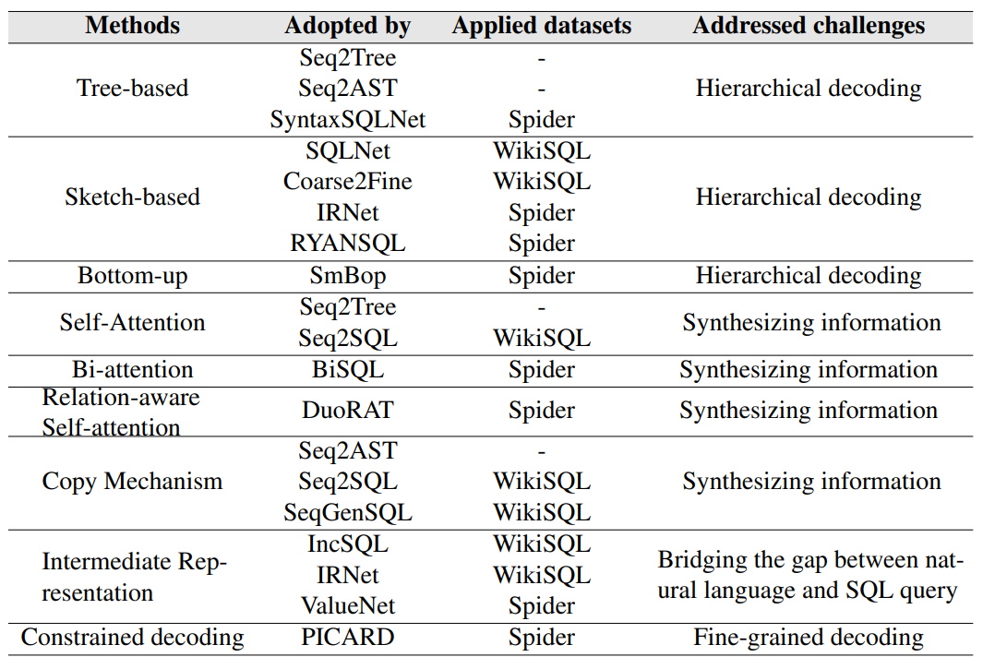
Decoders

Slide 59
Prompt Engineering
Rules:
Give ChatGPT an identity and intended audience "You are a text-to-sql assistant, do...”
Offer and give specific context
Highlight information to include or exclude
Choose a relevant tone of voice and writing style
Give examples to base the response on
Specify response length
Clarity and specificity
Notes:
Prompt engineering involves using LLM APIs for tasks like summarization, inference, text transformation, and expansion. It entails systematic development of high-quality prompts for optimal results.
Temperature, Maximum length, Top P, and Frequency and Presence penalties.
Top P is another method to control output randomness and creativity, and it influences the range of available tokens based on their relevance to the prompt.
Frequency and Presence penalties in the Playground regulate repetition in the generated text. Frequency penalties minimize word repetition, while Presence penalties reduce recurring specific topics. Higher values on the penalty scale indicate lower likelihoods of repeated tokens.

Slide 60
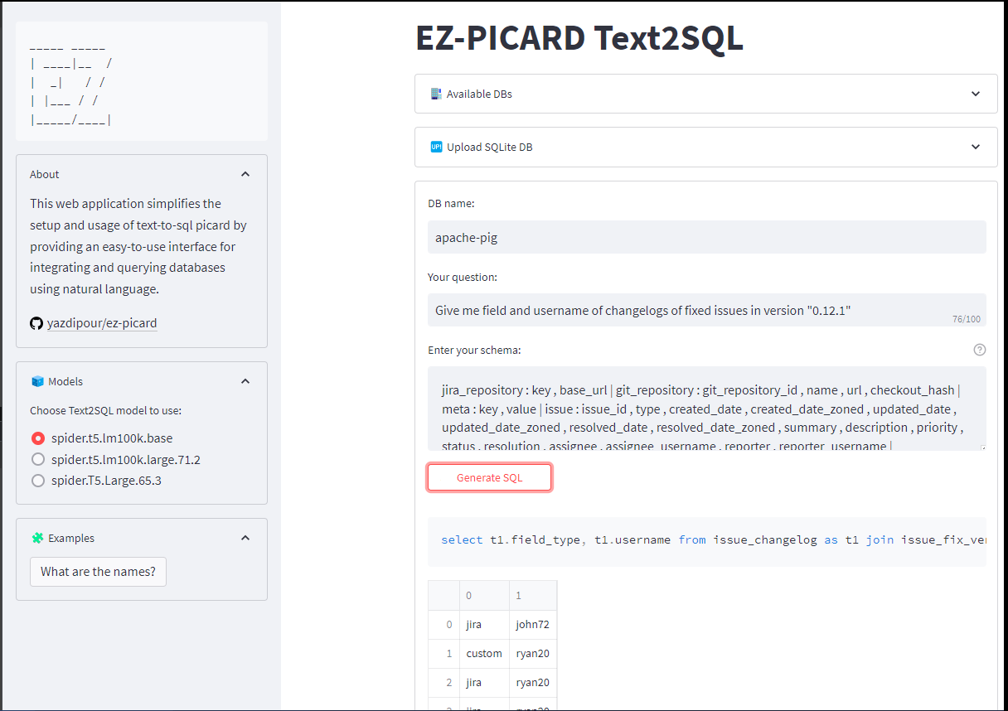
EZ-PICARD Text2SQL Client

Slide 61
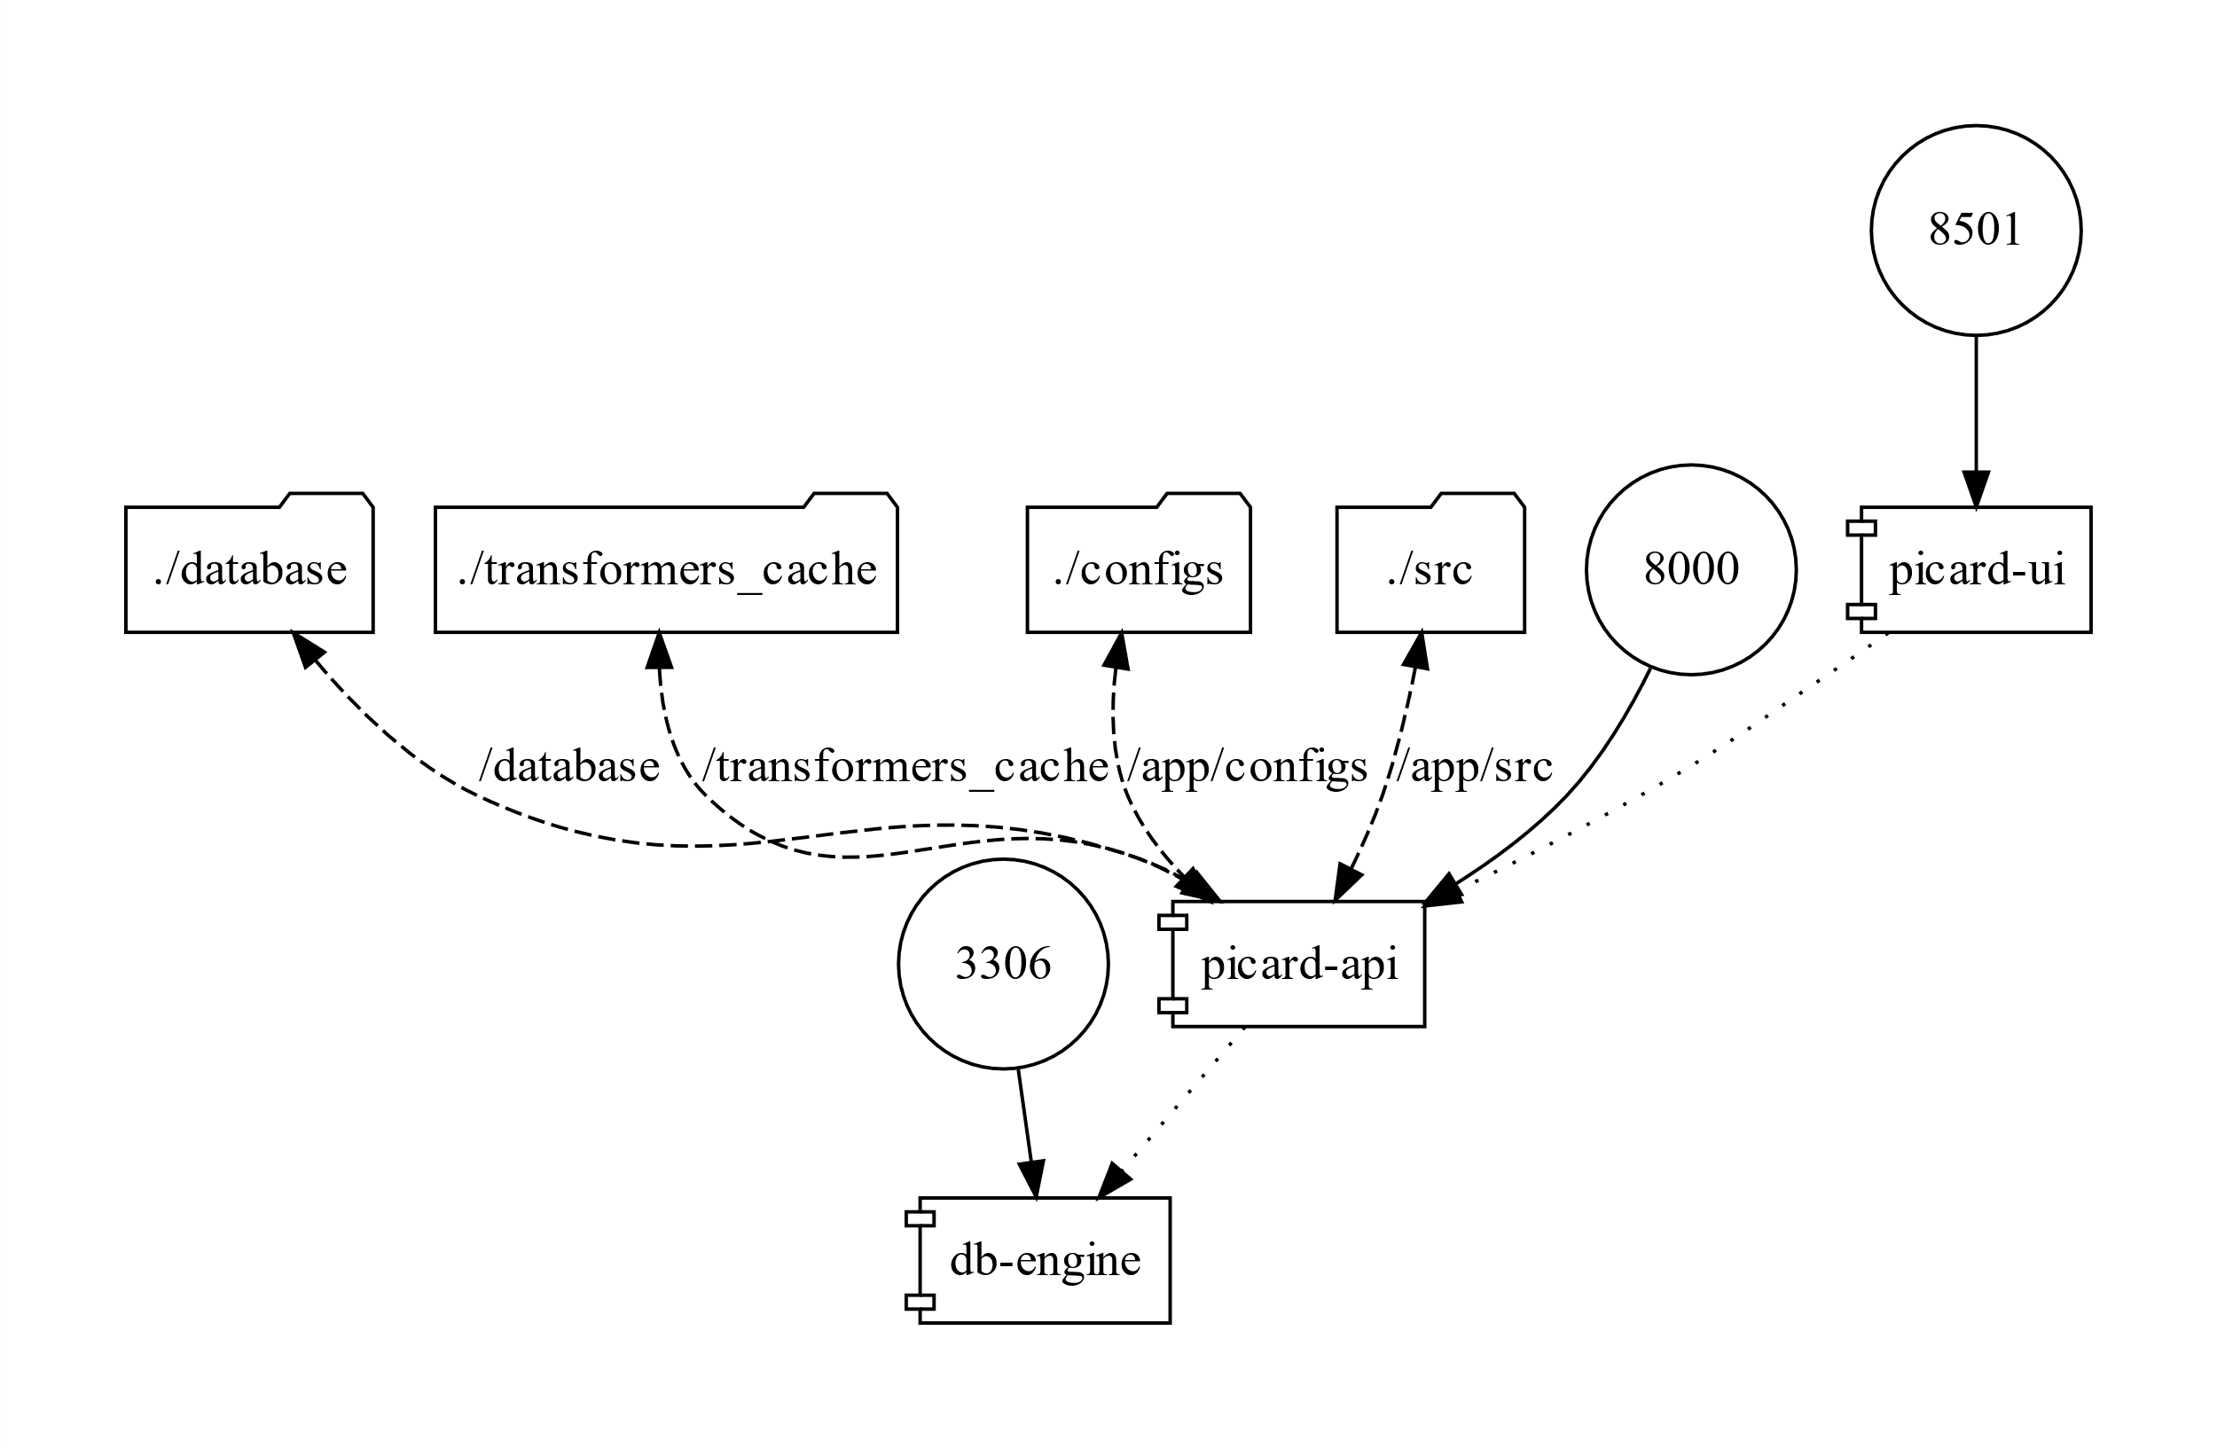
EZ-PICARD Text2SQL Client

Slide 62
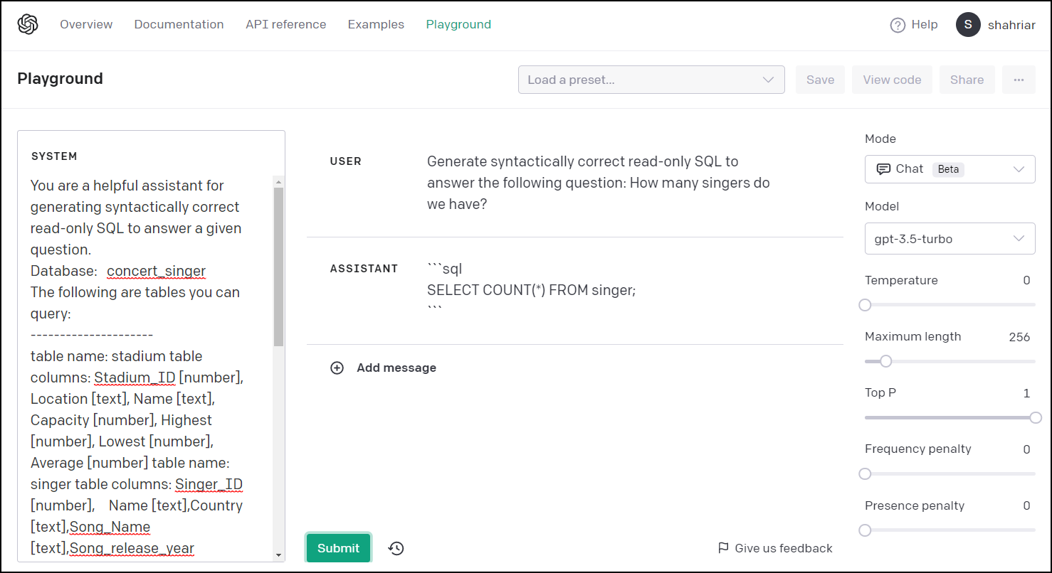
OpenAI Playground
Notes:
OpenAI Playground is a tool for exploring and experimenting with AI models like GPT-3 and GPT-4. It allows the development and testing of predictive language models using natural language processing techniques.
Prompt engineering involves using LLM APIs for tasks like summarization, inference, text transformation, and expansion. It entails systematic development of high-quality prompts for optimal results.
Temperature, Maximum length, Top P, and Frequency and Presence penalties.
Top P is another method to control output randomness and creativity, and it influences the range of available tokens based on their relevance to the prompt.
Frequency and Presence penalties in the Playground regulate repetition in the generated text. Frequency penalties minimize word repetition, while Presence penalties reduce recurring specific topics. Higher values on the penalty scale indicate lower likelihoods of repeated tokens.
Temperature controls the model's creativity, with a lower value yielding predictable responses and a higher value leading to creative outputs.
A temperature of 0 was found best for producing accurate SQL queries in this study.

Slide 63
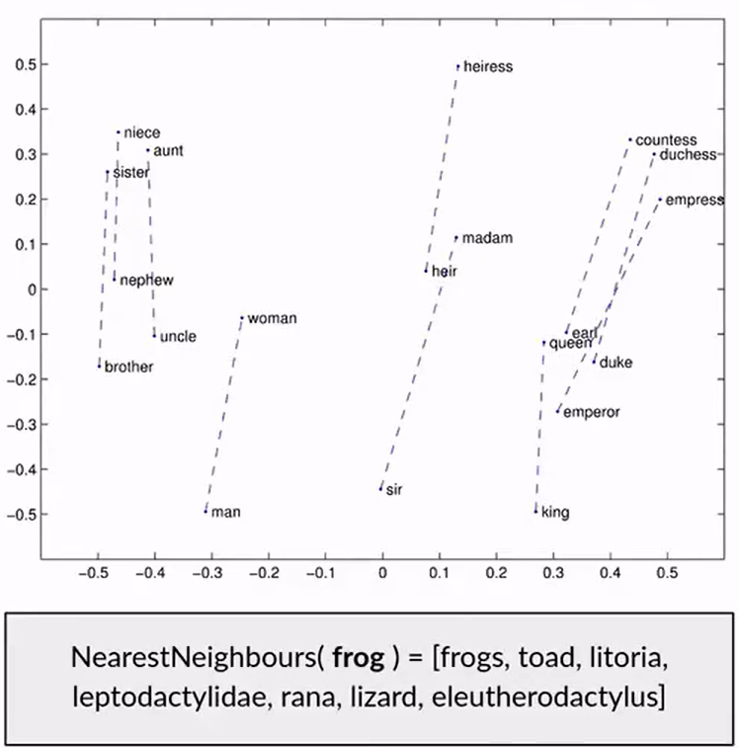
GloVe - Embedding
Create meaningful vector representations
Unsupervised learning based on word co-occurrence in the training corpus
Useful linear substructures for word relations
Easy to find semantical near neighbors
Pre-trained vectors created from large corpuses are available for download

Slide 64
Colossal Clean Crawled Corpus (C4 Dataset)
Unlabeled dataset gathered and filtered from CCD
Common Crawl Dataset: a non-commercial crawler that saves snapshots of the web every month. And web content is dumped out on the order of 20 terabytes.
The corpus is 'clean' because it undergoes a comprehensive cleaning process to remove inappropriate content, non-textual elements, and duplicates.
Notes:
The Colossal Clean Crawled Corpus (C4) is a large-scale dataset designed for training language models.
The goal of C4 and similar large-scale datasets is to help push the boundaries of what's possible in natural language processing and understanding.

Slide 65
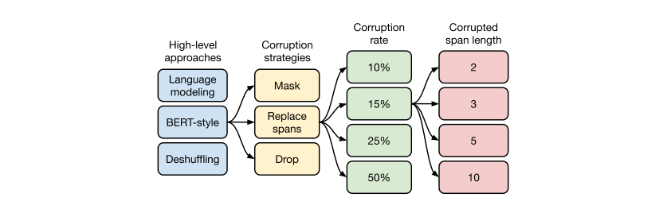
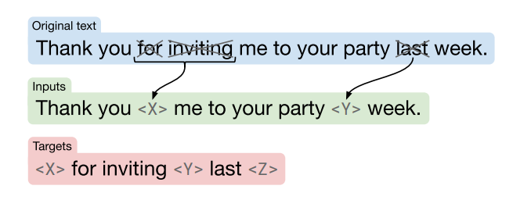
T5
Notes:
A flow chart Of our exploration Of unsupervised objectives. We first consider a
few disparate approaches in Section 3.3.1 and find that a BERT-style denoising
objective performs best. Then, we consider various methods for simplifying the
BERT objective so that it produces shorter target sequences in Section 3.3.2.
Given that replacing dropped-out spans with sentinel tokens performs well and
results in short target sequences, in Section 3.3.3 we experiment with different
corruption rates. Finally, we evaluate an objective that intentionally corrupts
contiguous spans of tokens in Section 3.3.4.

Slide 66
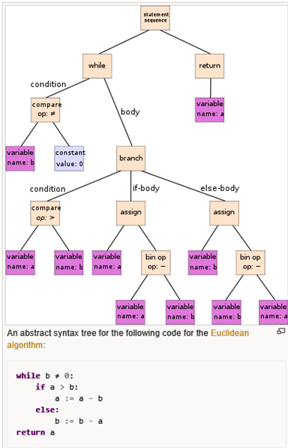
AST
Abstract Syntax Tree

Slide 67
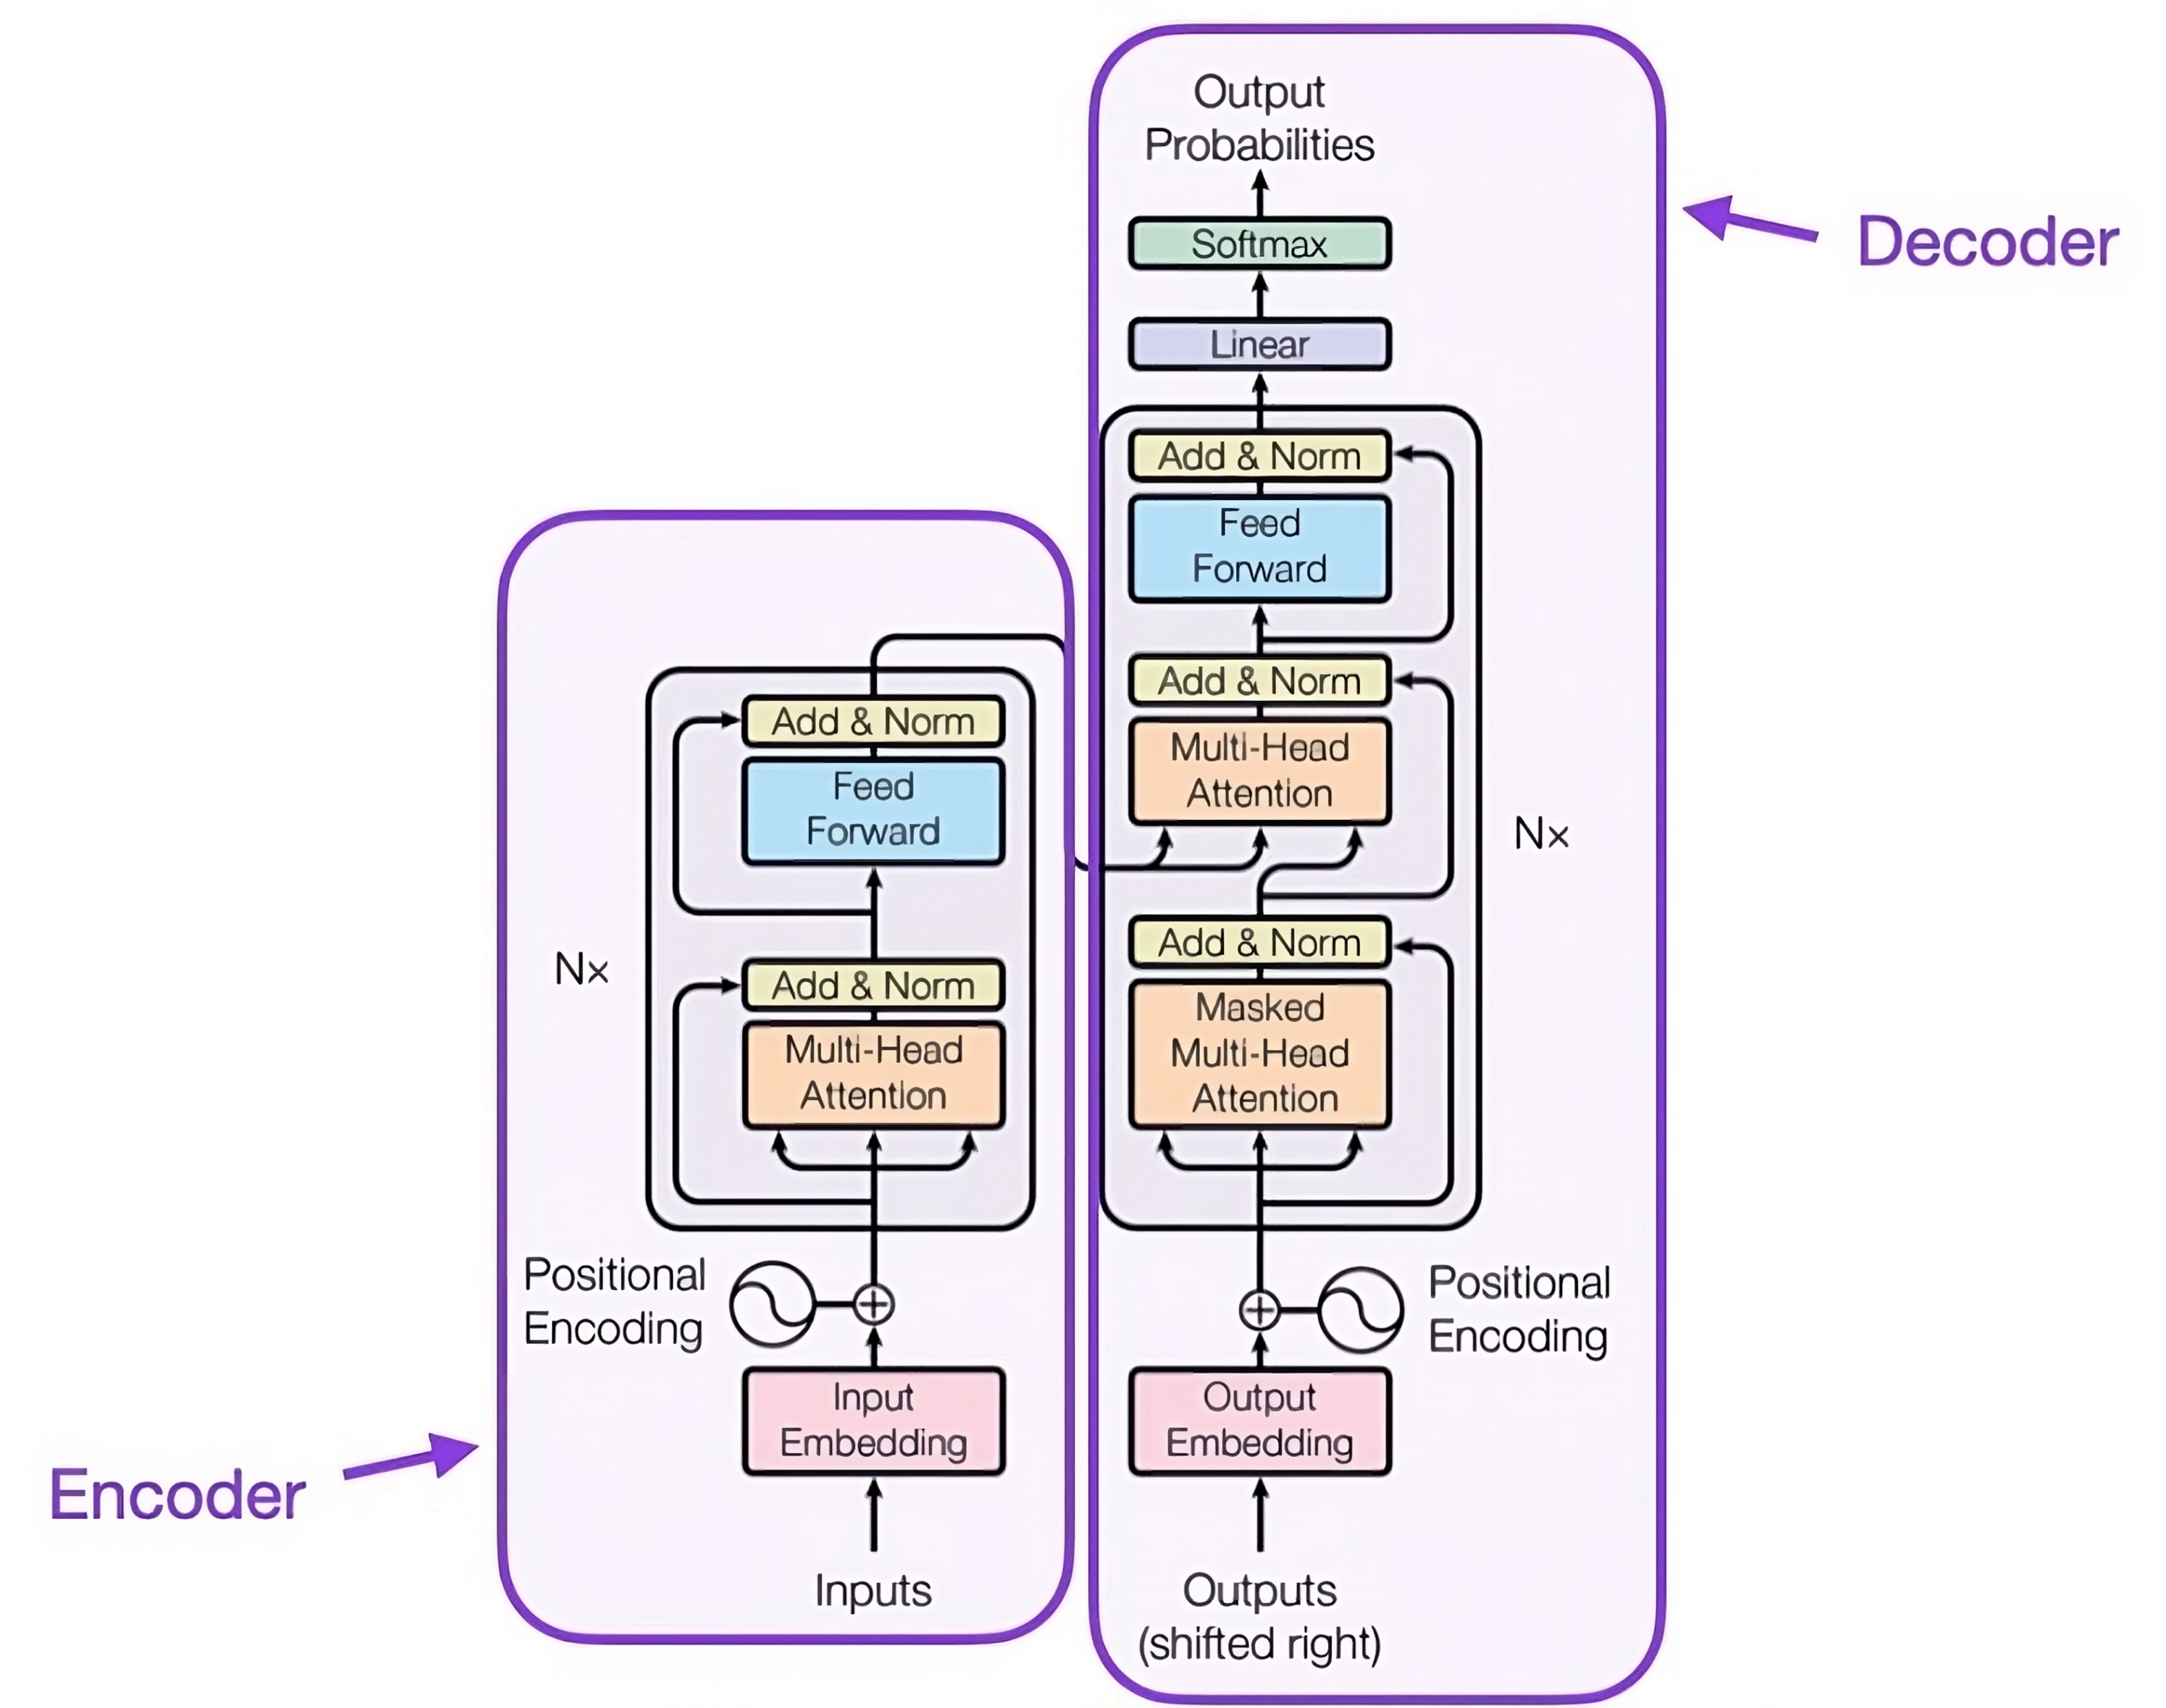
AST
Abstract Syntax Tree

Slide 68
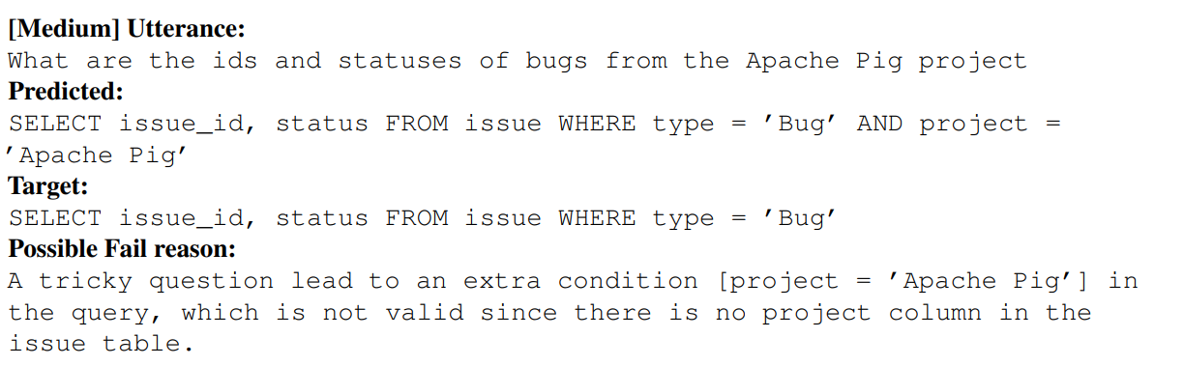
SEOSS Failed Cases

Slide 69
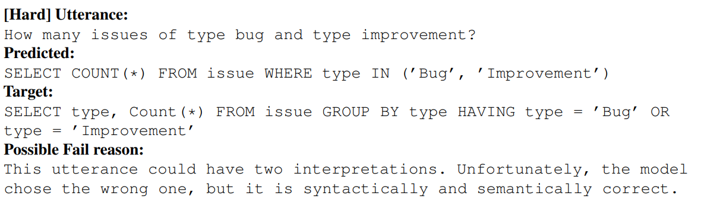
SEOSS Failed Cases

Slide 70
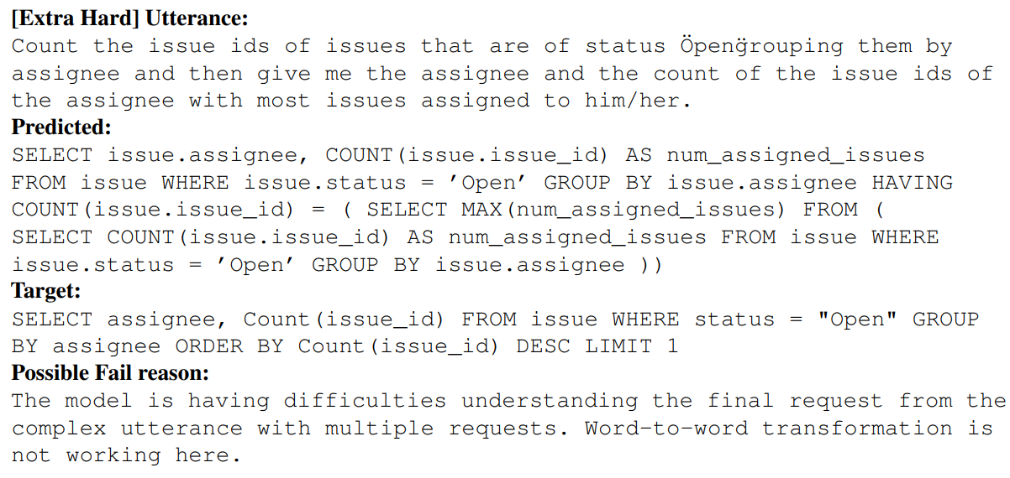
SEOSS Failed Cases

